Slide 1
Shoreland Surveys of McDill Pond Fall 2010 and 2013
Randy Slagg
Conservation Technician
Portage County Land Conservation Division
Nancy Turyk
Water Resource Scientist
Center for Watershed Science and Education

Slide 2
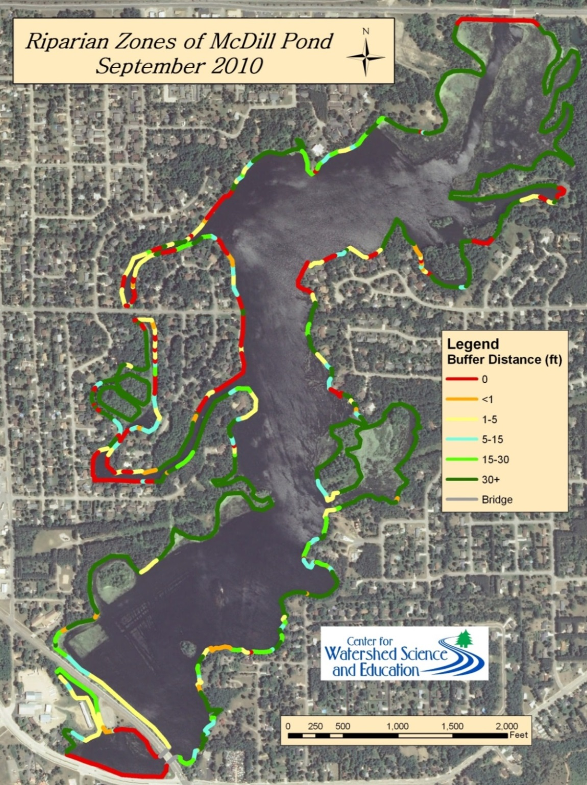

Slide 3
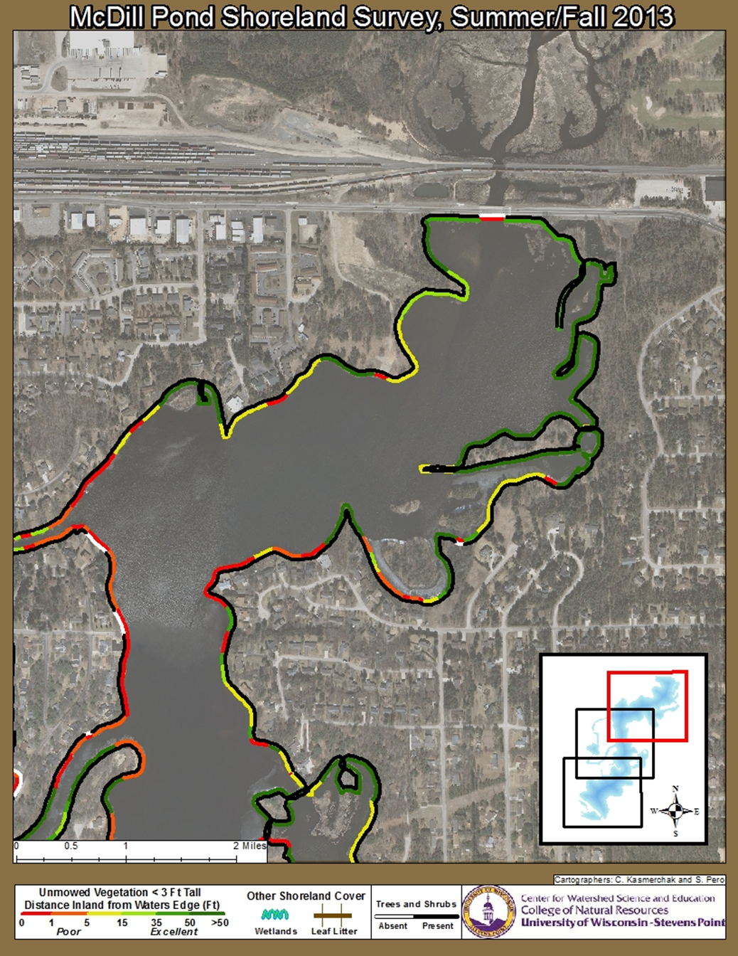
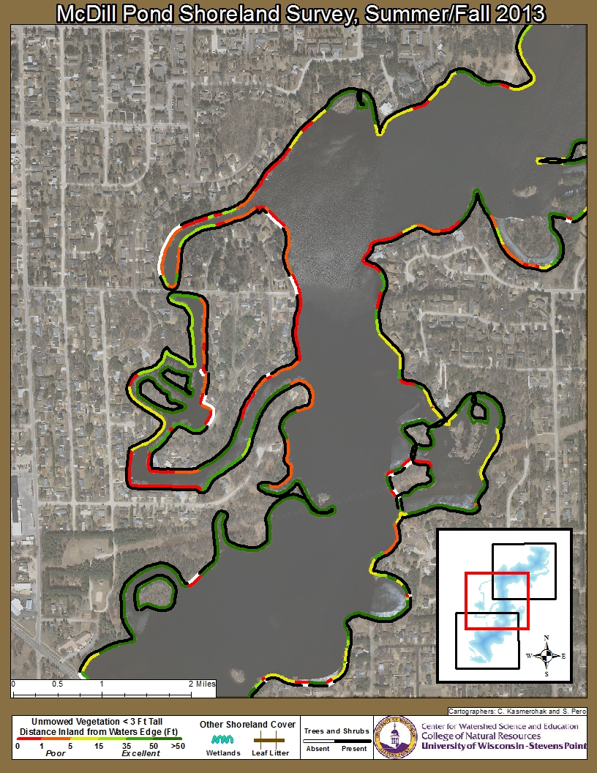

Slide 4
